Slide 1
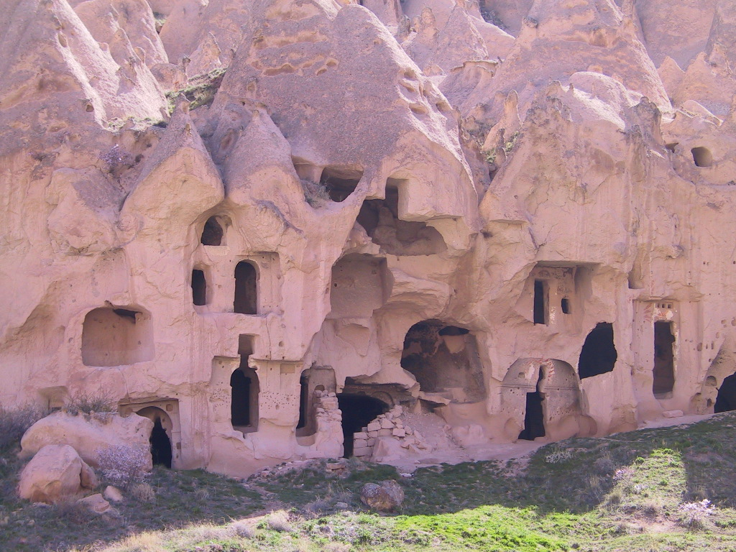
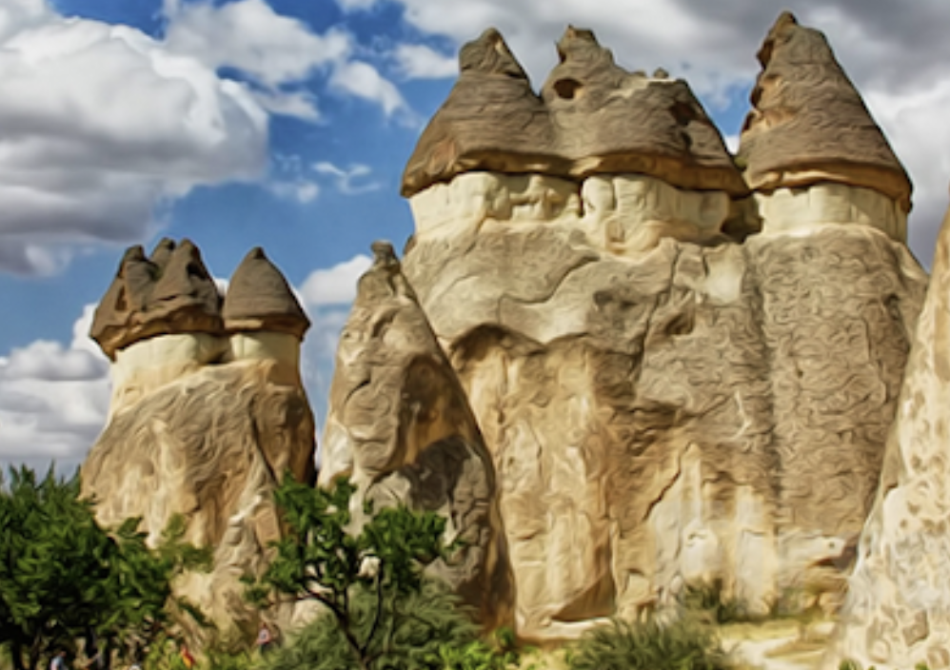
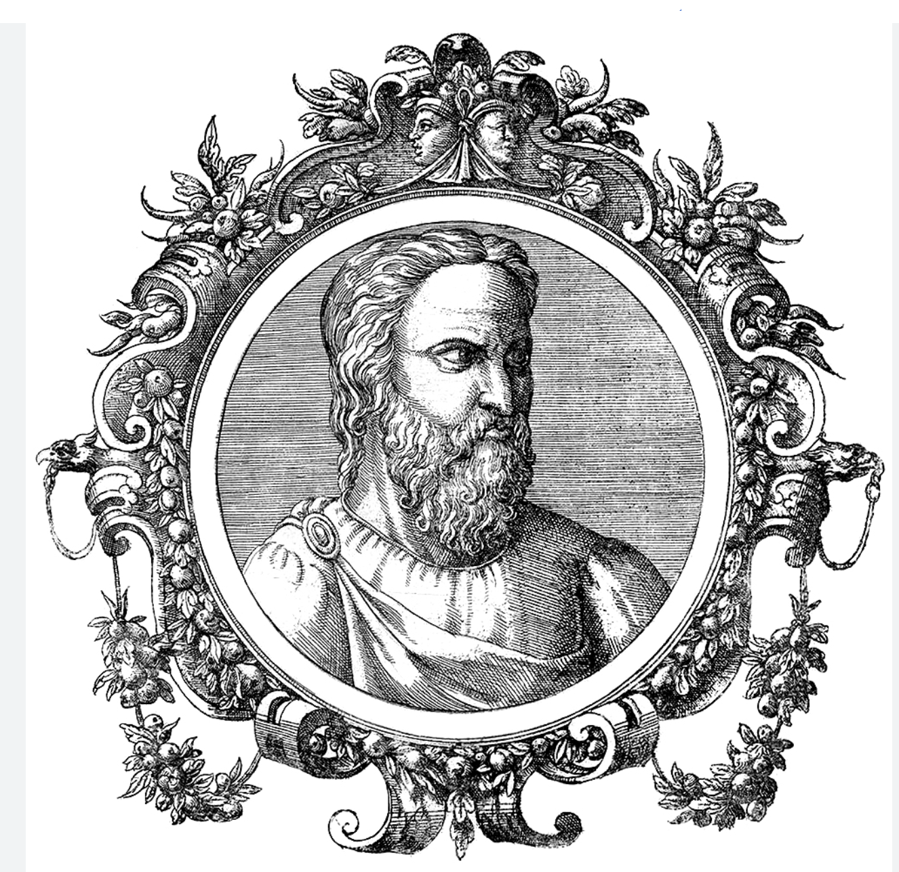
ARATEUS of the CAPODOCIA
Migraine, diabetes, epilepsia, psychiatry
F. Cankat Tulunay
Retied Professor of Medical School of Ankara University,
Dept. of Clinical Pharmacology &
Headache Research Center
TURKEY

Slide 2
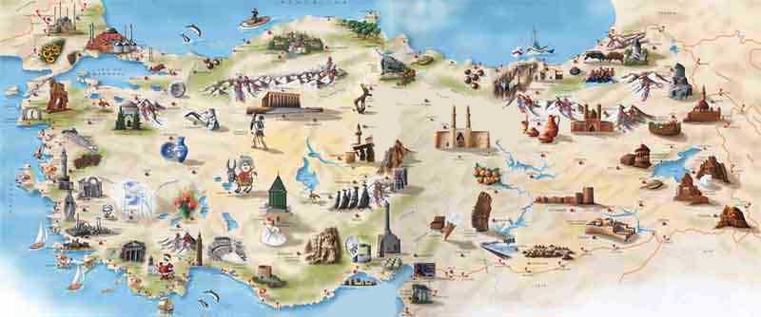
PYTHOGORUS (samos)
ASCLEPION (ASCLEPİDİAS)
GALEN (pergamum)
AVICENNA
(buhara)
SORONUS
RUFUS (ephesus)
LEUCIPPUS (miletus)
DIOGENES (bodrum)
ARATEUS (cappodocia)
HIPPOCRATES (cos)

Slide 3
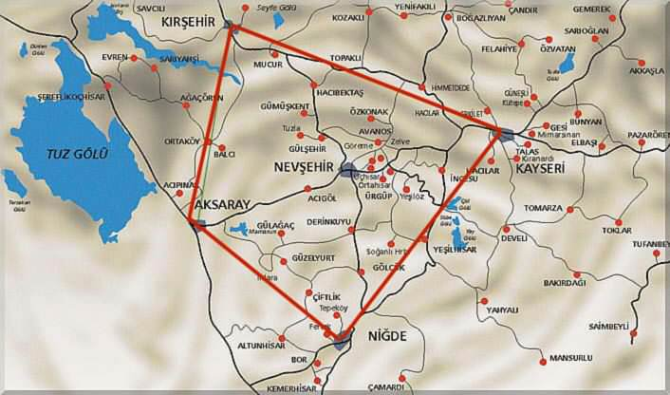

Slide 4
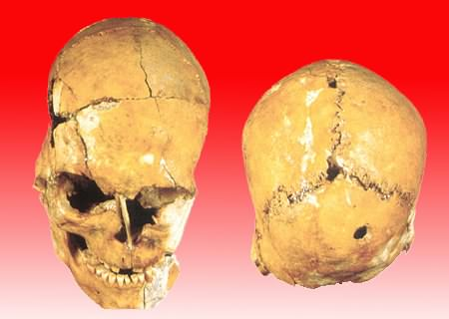
Prehistoric Period
Evidence provided by a skeleton found here indicates that the earliest brain surgery (trepanation) known in the world was performed on a woman 20-25 years of age at Asikli Höyük.
Hittite Period (1750-1200 BC)
People coming from Europe via the Caucasus, and settling in Cappadocia
around 2000 BC, formed an Empire in the region merging with the native people
of the area. Their language was of Indo-European origin.

Slide 5
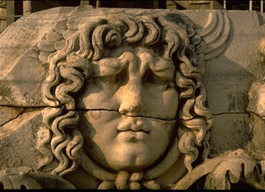
ARATEUS
Diabetes mellitus
Migraine
Epilepsy
Manic-depressive psychosis
Trigeminal neuralgia
Speculum
Egyptian Disease" or "Syrian Ulcer"
..............

Slide 6
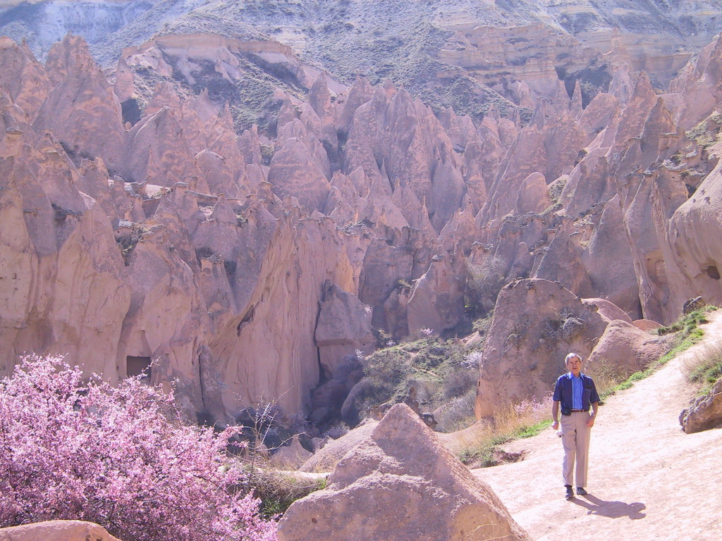
DIABETES MELLITUS
1552 B.C. Earliest known record of diabetes mentioned on 3rd Dynasty Egyptian papyrus by physician Hesy-Ra; mentions polyuria (frequent urination) as a symptom.
1st Century A.D. Diabetes described by Arateus as 'the melting down of flesh and limbs into urine.
The most significant advance in diabetes treatment since the description of the disease by Arateus almost 2000 yr ago was the discovery and use of insulin by Banting and Best in 1922.

Slide 7
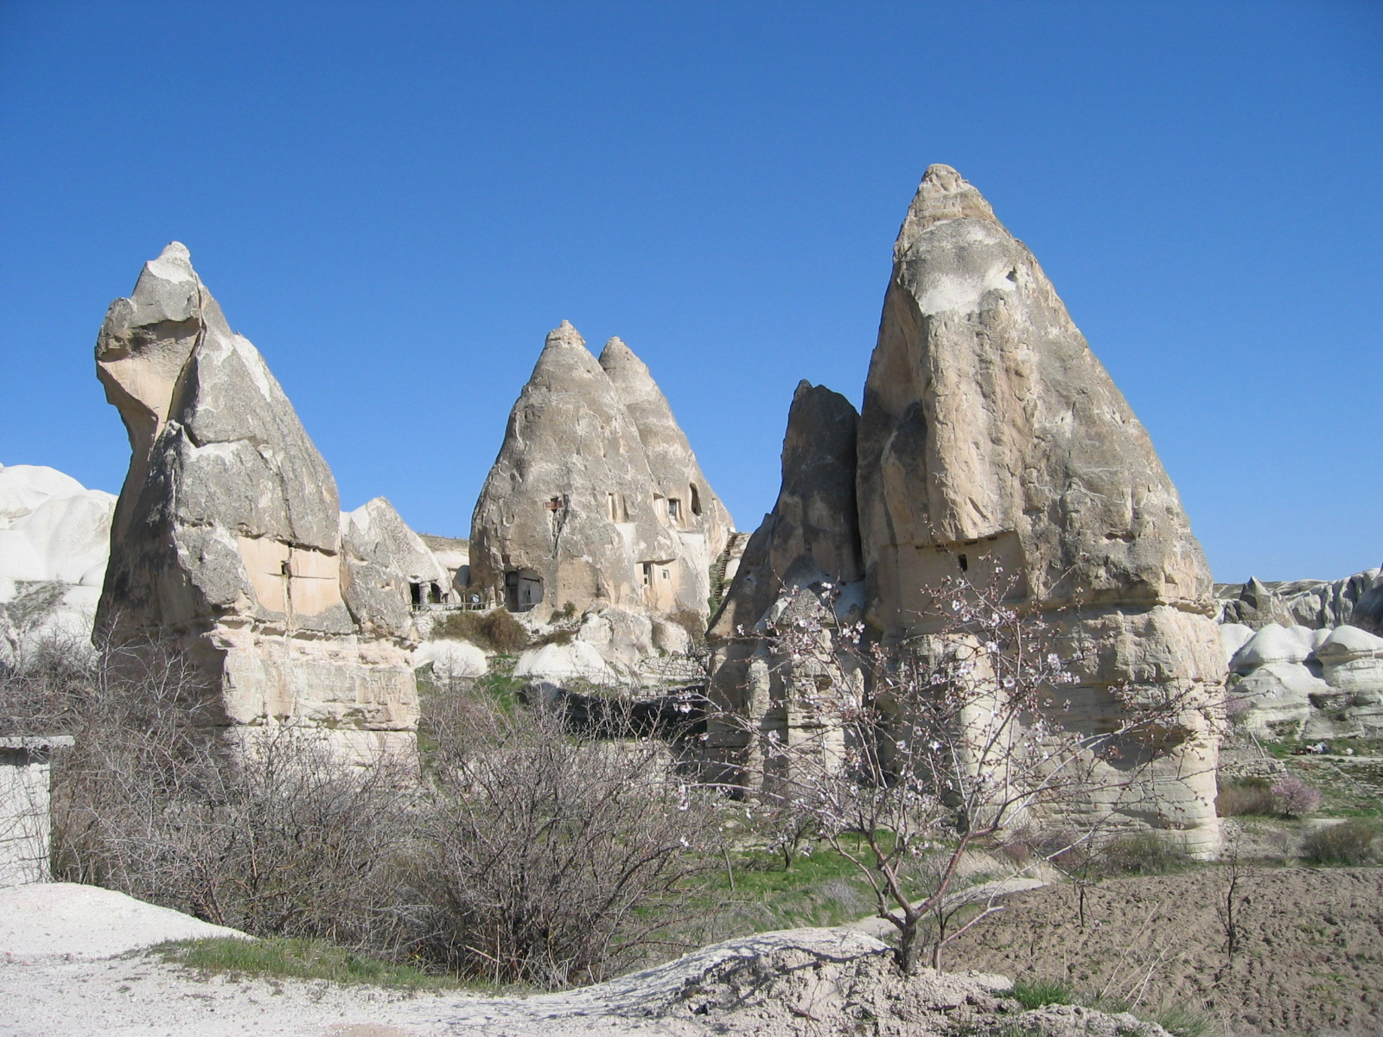
Diabetes mellitus
The following was written by Areteus the Cappadocian, sometime in the second to third century AD.
Diabetes is a wonderful affection, not very frequent among men, being a melting down of the flesh and limbs into urine. Its cause is of a cold and humid nature as in dropsy.
The course is a common one, namely the kidneys and bladder; for the patients never stop making water, but the flow is incessant, as if from the opening of aqueducts.
The nature of the disease then is chronic, and it takes a long period to form, but the patient is short-lived if the constitution of the disease be completely established; for the melting is rapid, the death speedy.

Slide 8

Diabetes mellitus
Medicines then which cure thirst are required, for the thirst is great with an insatiable desire of drink, so that no amount of fluid would be sufficient to cure the thirst. We must, then, by all means strengthen the stomach, which is the fountain of the thirst.....
But the water used as drink is to be boiled with autumn fruit. The food is to be milk, and with it cereals, starch, groats of spelt, gruels. Astringent wines to give tone to the stomach, and these but little diluted, in order to dissipate and clear away the other humours; for thirst is engendered by saltish things.

Slide 9

6000 years ago when the Sumerians stated in Heaven:
The sick eyed says not I am sick eyed. The sick headed (says) not I am sick headed.
“Sick-eyed” might simply indicate an eye complaint and “sick-headed” means headache
3500 BC: Courtesan of Pharoah’s court, a case report to be found in the Ebers papyrus, where the disorder is described as “sickness of half the head”.

Slide 10
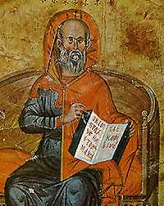
Hippocrates
440-390 BC: Hippocrates distinguished different types of headaches in his Aphorism, and was the first state that this was a true disorder and not a visitation from the gods.
He was the first to describe several well-known features of migraine, vizuel aura, the onset of headache after the aura, the headache becoming generalized and its relief by vomiting.

Slide 11
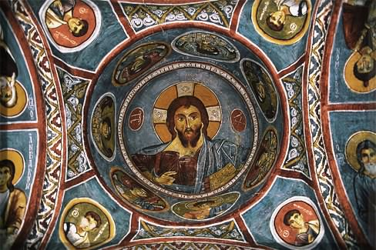
Celsus (25 BC to 50 AD) was the first to indicate that migraine was a life-long non-fatal disorder, that there were trigger factors.
Soranus of Ephesus (90-138 AD) described scotoma.
Galen (131-201 AD) used the term HEMICRANIA, which gave rise to the woed migraine.

Slide 12
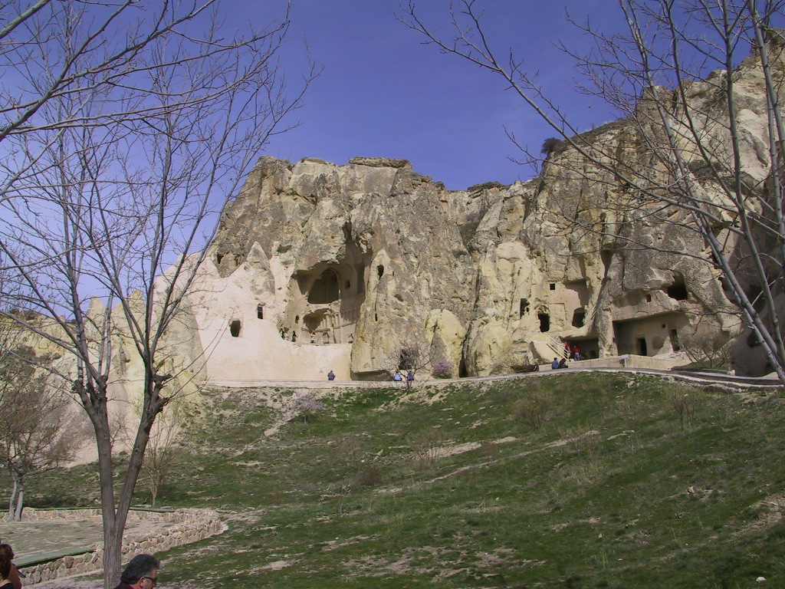

30-90 AD: Arateus of Cappococia:
He reported 3 different types of headache
Cephalalgia: which was mild, infrequent, lasted several days, and may well have been tension type headache
Cephalea: which lasted longer, was more severe, difficult to treat, and probably due to a structural cause
Heterocrania: which was a one-sided headache with blackness before the eyes, nausea, vomiting, photophobia and osmophobia (MIGRAINE)
If they begin at dusk, they end by midday on the next day, and if begin at midday, they end by nightfall. “It is rare for the attack to last longer”. The attacks lasted from 6 to 24 hr. Headache could be either side, frontal or vertical and, during the same day, vary. When the pain is localised, it is called heterocrania.

Slide 13
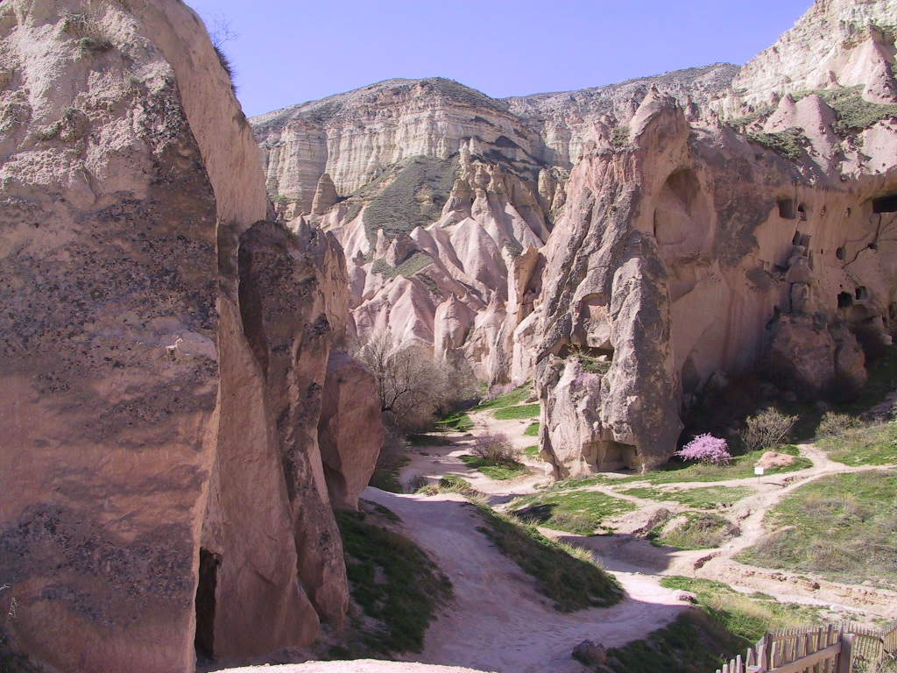
30-90 AD: Arateus of Capadócia :
Arateus of Capadócia : many other doctors with migraine, Arateus took particular interest in his own illness and gave an accurate clinical description, describing in more detaile the visual aura: “... Flashes of purple on black colours before the sight, or all mixed together..”
He was also the first to describe the photophobia and phonophobia of migraine

Slide 14
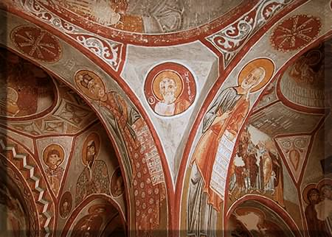
His headache
...the pain.. Remains in the half of the head. This is called heterocraina, an ilness by no means mild, even though it appears to be slight...
it sets in acutely, it occasions unseemly and dreadful symptoms ... nausea; vomiting of bilious matter, heavinessof the head,anxiety and weariness .... the darkness soots their disease...

Slide 15
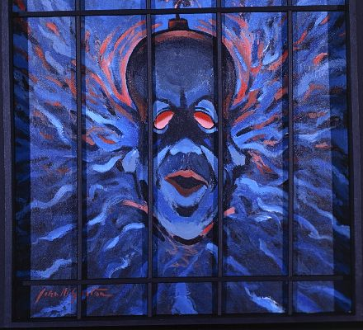
The Greek word, hemicrania, was changed by the Romans to the Latin, hemicranium, and then corruted into low Latin as hemicraia, them emigranea, migranea and migrana.
In English, it appeard as mygraine (1398), myegrym (1460), migrien (1579), and megrim (1713). Migraine appeard in English (from the French) in 1777. Megrim has neen spelled in 33 different ways.

Slide 16

Ancient man saw mental illness as possession by supernatural forces.
Ancient human skulls have been found with large holes in them, a process that has become known as trepanning. The accepted theory is that it was an attempt to let evil spirits out.
Hipócrates (450 B.C.), doctor of Cós, described a picture of sadness, apathy, loss of auto-esteem the one that called melancholy, therefore believed to be originated by the black bile (melanos = black cholle = bile).
This term crossed the times, being used for medical authors as Arateus (120 -180 A.C.) and Galeno (129-199 A.C.).

Slide 17
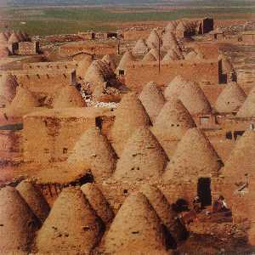
DEVELOPMENT OF PSYCHIATRY
Prehistorical: Mental illness regarded as alternate reality; treatment administered by respected member of community. Holistic approach is common.
Egypt, 2850 B.C.: Sleep therapy. Nile excursions, music, dancing, painting.
Mesopotamia, 2000 B.C.: Division of labor betwen treatment of physical and mental ailments, holistic approach, beginning of psychotherapy.

Slide 18
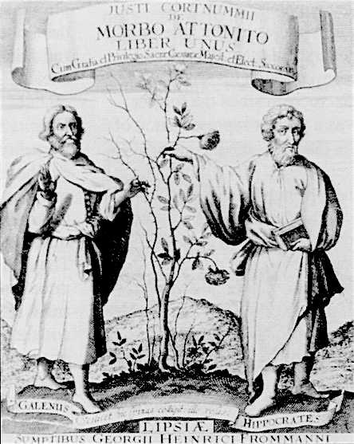
DEVELOPMENT OF PSYCHIATRY
5th Century B.C.:
Hippocrates documented many forms of mental illness, isolates the brain as the seat of throughts and emotions, and becomes an expert witness in that field.
Plato proposes a precursor to Freud’s ego, superego and ide.
4th Century B.C.:
Aristotle combines actions, feelings, and thoughts into an integrated whole, describes genetic influences on mental health, and deals with will and rationality; Aristophanes writes plays that include an early version of Freudian free association.

Slide 19
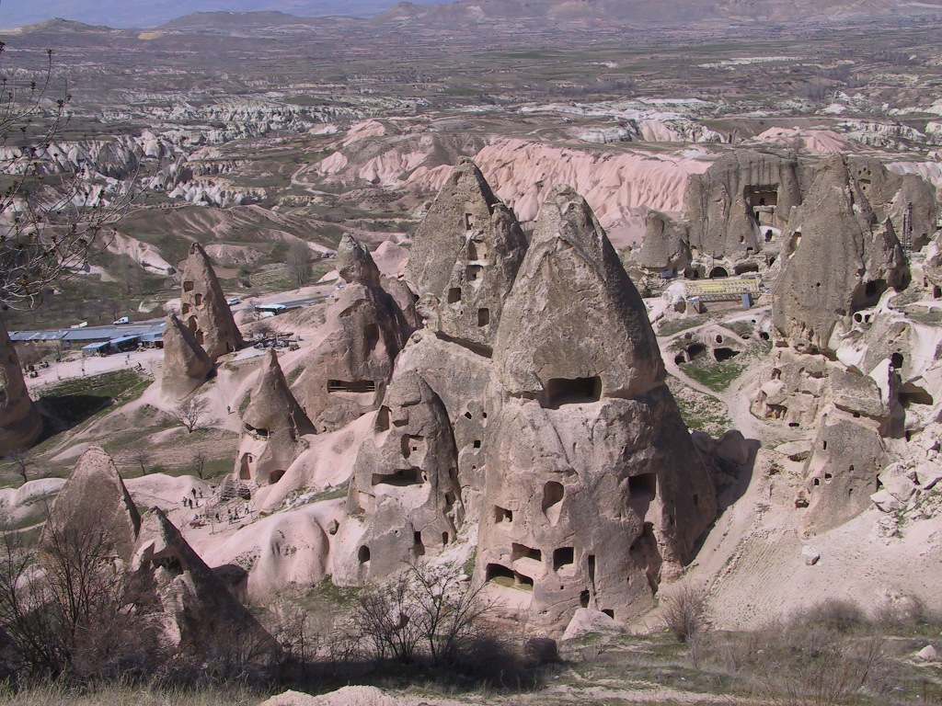
DEVELOPMENT OF PSYCHIATRY
50-130 A.C.: Arateus writes an accurate description of bipolar illness; views normal and abnormal behavior as a continuum.
9th-10th Century A.C: Rhazes operates hospital in Baghdad with a separate psychiatric ward, where patients are humanely treated.

Slide 20

ARATEUS
…those affected with melancholy are not every one of them affected according to one particular form but they are suspicious of poisoning or flee to the desert from misanthropy or turn superstitious or contract a hatred of life.
The patients are dull or stern, dejected or unreasonably torpid……they also become peevish, dispirited and start up from a disturbed sleep.

Slide 21
Arateus was the first to suggest that the origin of mental disorder might not be specifically localised. It could originate from the head or abdomen and the other could be affected as a secondary consequence.
He also worked on ideas about premorbid personalities and discovered that individuals who became manic were characteristically labile in nature, easily irritable, angry or happy. Those who developed melancholia tended to depression in their premorbid state.
Emotional disorders were merely an extension or exaggeration of existing character traits, a very original idea for the time. He also observed that mania and depression could occur in the same individual, thereby anticipating Kraeplins’ work on mania and melancholia being part of one disorder by many centuries.

Slide 22
Arateus and Galen (30-90 AC)
Souls | Location | Function
Rational | Brain | Controls internal and external functions Internal: imagination, judgement, memory, apperception, movement External: 5 senses
Irrational | Heart and Liver | Controls all emotions

Slide 23
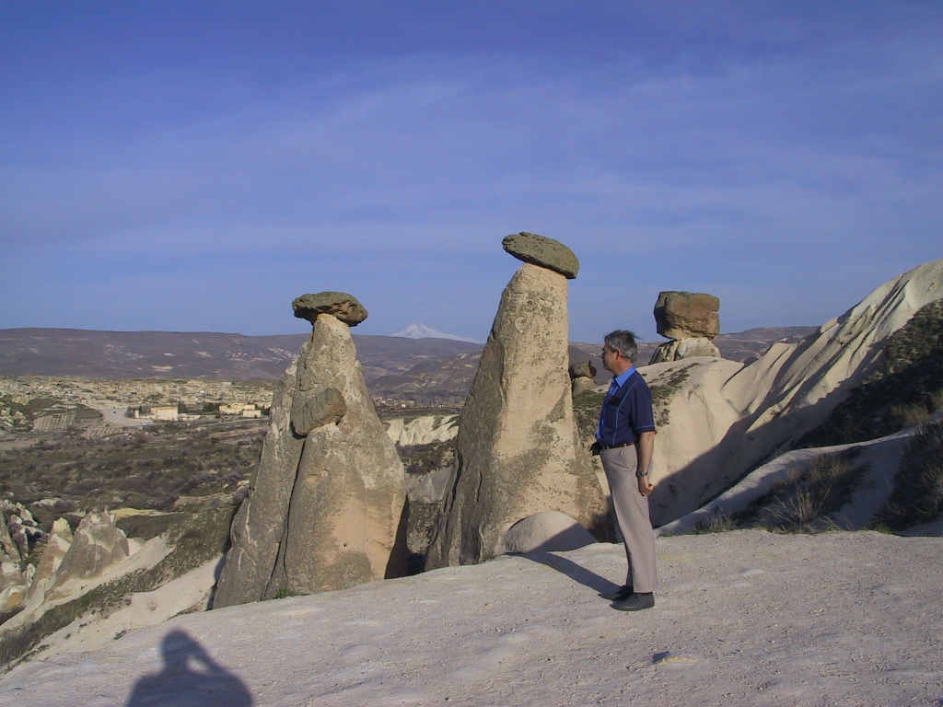
Trigeminal Neuralgia:
Arateus first described TN or tic douloreux (French for "painful tic") in the first century AD.
In 1677, John Locke was the first physician to describe the condition.
Nicolaus Andre characterized it as a distinct clinical entity in 1756.
TN is the most common facial neuralgia, and is considered to be one of the most painful conditions to affect patients.

Slide 24
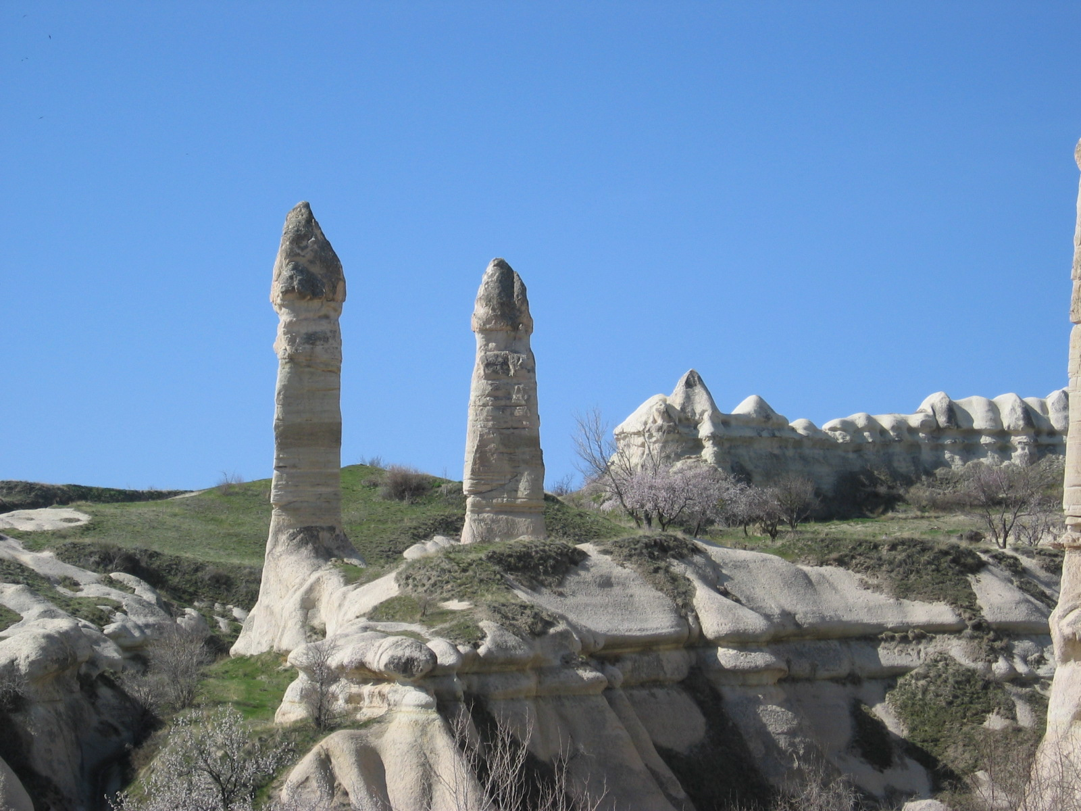
EPILEPSY
In century II, Arateus of the Capadócia described the aura of the epileptic crisis in the Pneumatic School of Greco-roman Medicine.
At the time of Galenos (130-200 AC) the popular belief started to associate the epiletic attack with lunar alterations and the patients were called lunatics, persisting this idea until century XVII.
In the medieval Europe, the cause of the epilepsy was attributed to the magical or religious factors.
It started to appear the practical one of exorcisms (witches had blunted). In that occasion it had a mixture and confusion between: religion, misticism, witchcraft and histeria.
In century XVI (1493-1541), the Paracelsus associated the epilepsy with histeria and described the epilepsy as contagious disease.

Slide 25
Arateus the Cappadocian, in the 2nd Century A.D. under the names "Egyptian Disease" or "Syrian Ulcer", described ulceration of the tonsils, regurgitation of food through the nose, and suffocation.

Slide 26

SPECULUM
The first evidence that a speculum was used in antiquity is found in the Talmud about 1300B.C.
The present name of speculum was adopted in the Roman era, and it was Galen (AD 130-200) who made the first record of a speculum. In 1818 in the excavation of Pompeii two specula were found which were estimated to have been buried in AD 79. These were bronze dilators; one with three and the other with four blades which diverged when a centrally located screw is turned and they were used in the time of Galen and Celsus (27 BC to A.D. 50) and very likely in the Middle Ages.
At about the second century, speculum was described in several medical books of the time. Soranus of Ephesus, Arateus, Archingenes, Aspasia and Leonido, are few of the physicians who recognised the association of speculum with anorectal and gynaecological examination.

Slide 27
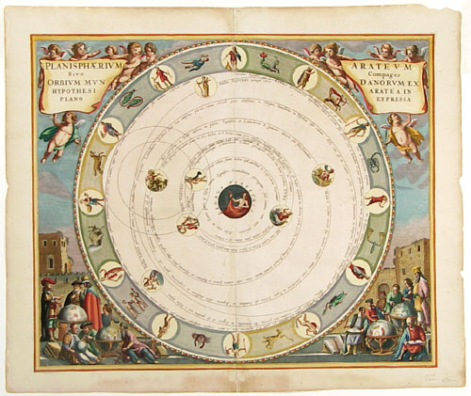
Ancient Greek Solar System. CELLARIUS, A. [Amsterdam, 1660] Saturn was the outermost planet in ancient cosmology, as it is the furthest planet visible with the naked eye. Knowledge of the ancient Greek solar system derived from an epic poem by Arateus, referred to in the chart's title, which was written in the third century B.C.

